Slide 1
How to Use This Notebook
How to Use This Notebook
DELETE ME
怎么用这本笔记 · 交笔记前请删除这一页
1
Every page: fill in Project, Name, Date and Page at the bottom.
每一页底部都要写：项目、作者、日期、页码。
2
Write on the same day you build, code or test.
当天做的事当天记，不要比赛前再补。
3
Gray text is a prompt. Write your own answer, then delete the gray prompt.
灰色字是提示。用自己的话回答，写完把灰色提示删掉。
4
Need more pages? Right-click the slide on the left → Duplicate slide.
页数不够？在左侧右键这一页 → 复制幻灯片。
5
Put numbers (1, 2, 3) on every photo and explain each number.
照片上标数字 1、2、3，并逐条说明每个数字是什么。
6
Change ONE thing at a time. Test it 10 times. Write down the results.
一次只改一处，测 10 遍，把结果记下来。
7
Keep ideas that failed. They show how we learned.
失败的想法也要保留，它能证明我们是怎么一步步改进的。
8
Use exact numbers: scores, seconds, gear ratios, success rate (8/10).
多写具体数字：分数、秒数、齿轮比、成功率（如 8/10）。
9
Before each event: update the Table of Contents and the 3 Summary pages.
每次比赛前：更新目录和三张 Summary 页。
10
All the writing is ours. Grown-ups can teach us, but we write it ourselves.
所有内容都由我们自己写。大人可以教，但要自己动笔。
Page order: Team → Game → Robot design cycle (repeat for each robot) → Competitions → Appendix
页面顺序：团队 → 赛题分析 → 机器人设计循环（每台机器人重复一遍） → 比赛 → 附录

Slide 2
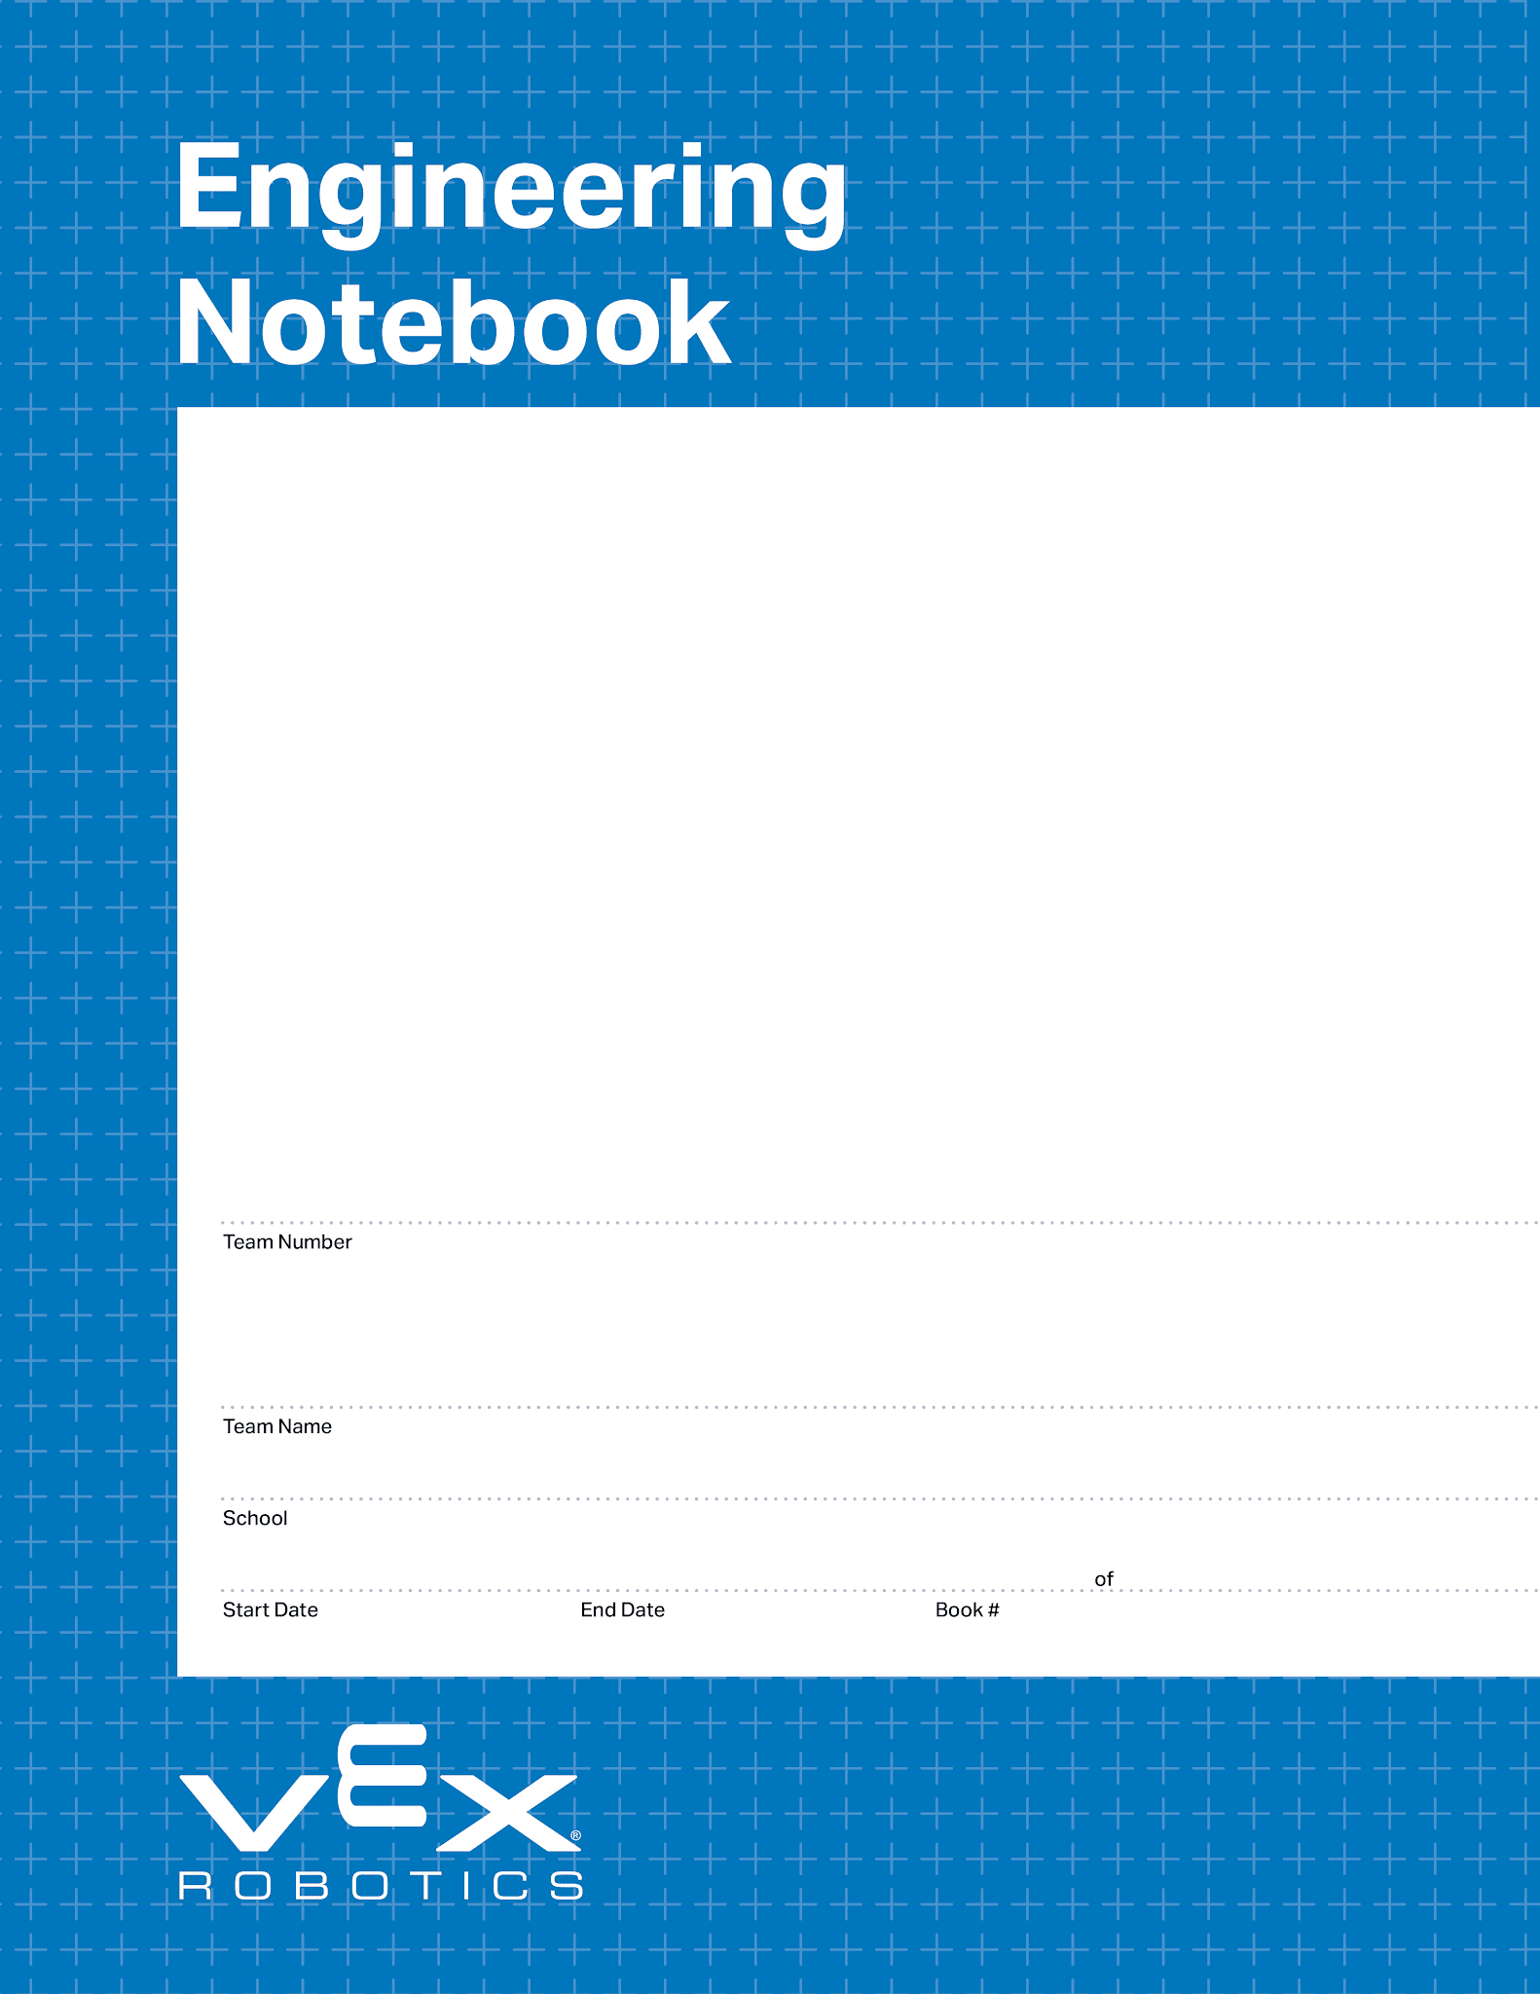
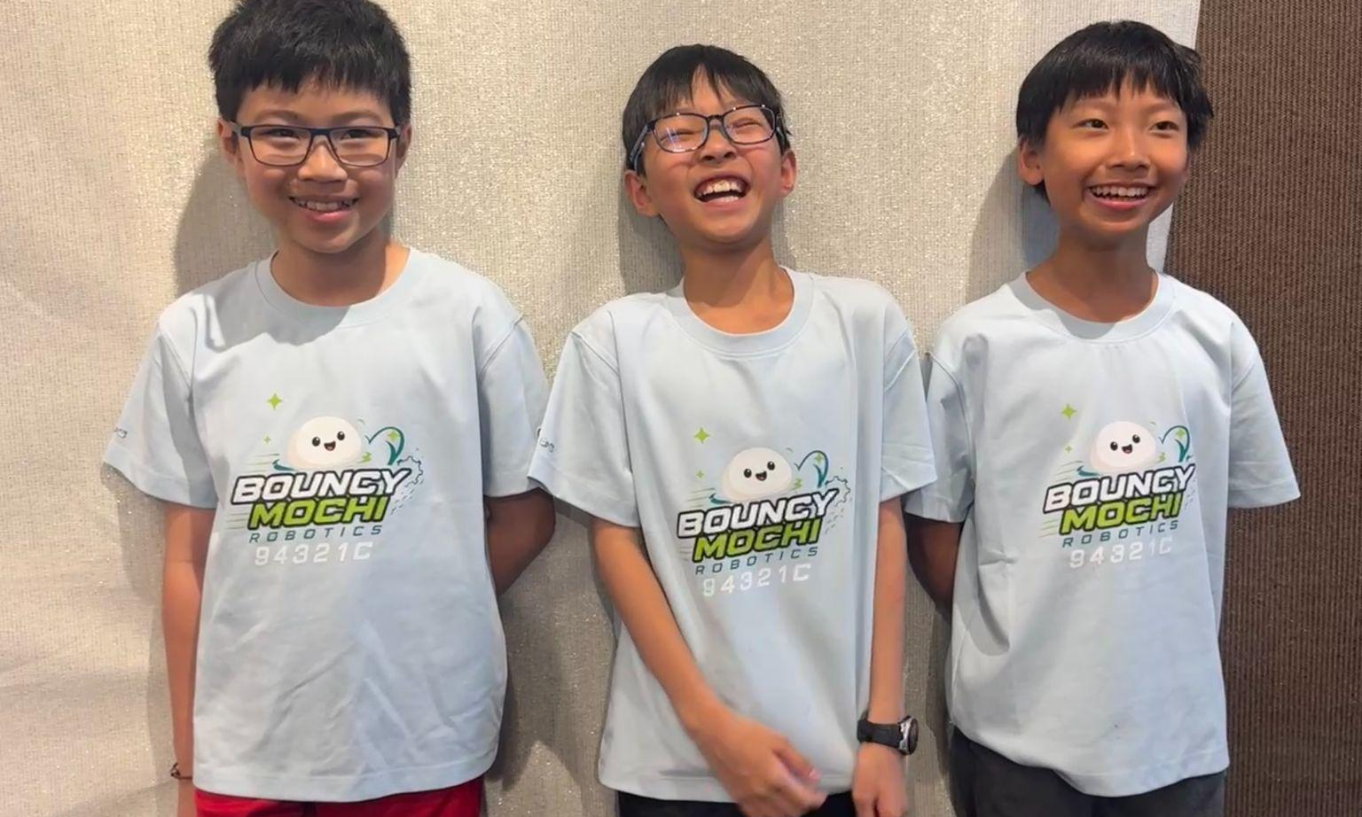
Team photo here · 团队合照放这里
94321C
Bouncy Mochi
Palo Alto Robotics
08/15/2026
10/25/2026
1
1
V5.1 Date 10.12.26

Slide 3
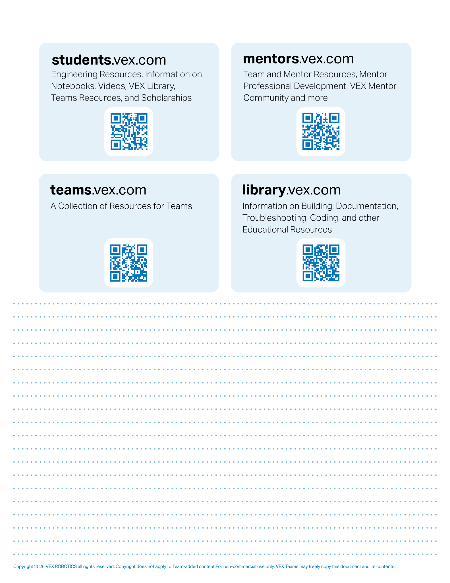

Resources
engineering.vex.com
notebooking.vex.com
coding.vex.com
vex.com
VIQRC 2026-2027 Game - Rules & Game Video
Send suggestions and comments about these Digital Notebooks and Digital Parts
to notebooks@vex.com

Slide 4
Summary
Season Summary
SUMMARY
赛季总结 · 每次比赛前更新（按官方 Summary 页说明填写）
Our Robot
Our robot in a few sentences: what it does and how it scores.
用几句话介绍我们的机器人：它做什么、怎么得分。
Key Decisions
Our biggest design decisions this season and why (add page numbers).
本赛季最重要的几个设计决定和原因（写上对应页码）。
Results So Far 目前成绩
Event 比赛 | Date 日期 | Auton 自动 | Driver 手动 | Skills Total Skills 总分 | Awards / Rank 奖项 / 排名
What's Next
What we are working on next, and our goal for the next event.
下一步要做什么，下一场比赛的目标是多少分。

Slide 5
Summary
Code Summary
SUMMARY
程序总结
Language
We program in: (VEXcode IQ Blocks / Python / C++)
我们用的编程方式（积木 / Python / C++）
Driver Control 手动控制
Button 按键 | What it does 功能 | Page # 页码
Autonomous Routines 自动程序
Routine name 程序名 | What it scores 得什么分 | Sensors used 用了哪些传感器 | Page # 页码
Our Best Code Idea
The code idea we are most proud of, and how it works.
我们最得意的一段程序，以及它的原理。

Slide 6
Summary
Credit Summary
SUMMARY
署名总结 · 谁做了什么、得到了谁的帮助
Who Did What 分工
Team member 队员 | Main jobs this season 本赛季主要负责 | Pages written 写了哪些页
Leo
Jasper
Help We Received 得到的帮助
Who helped 谁帮了我们 | What they helped with 帮了什么
Ideas & Resources We Learned From 参考过的设计和资料
Source (video, website, team) 来源（视频、网站、其他队） | What we used or learned 我们学到或借用了什么

Slide 7
1-5 Our Team 8/15/2026 Understanding the Game

Slide 8
12345 Title Title Title Date Date Date

Slide 9
Our Team

Slide 10
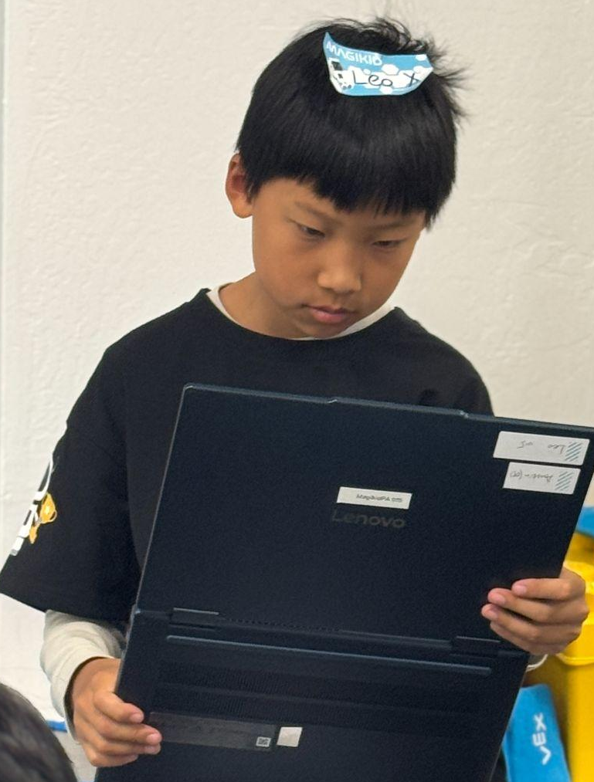
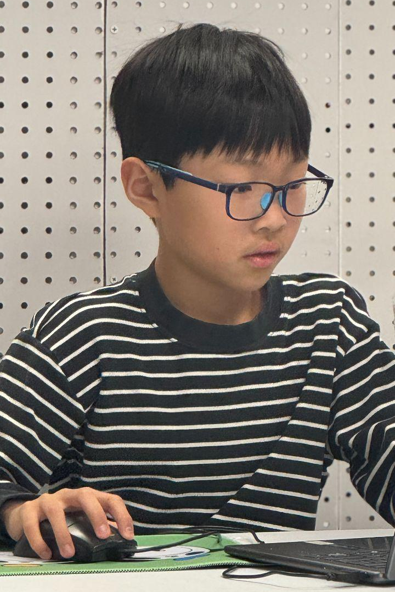
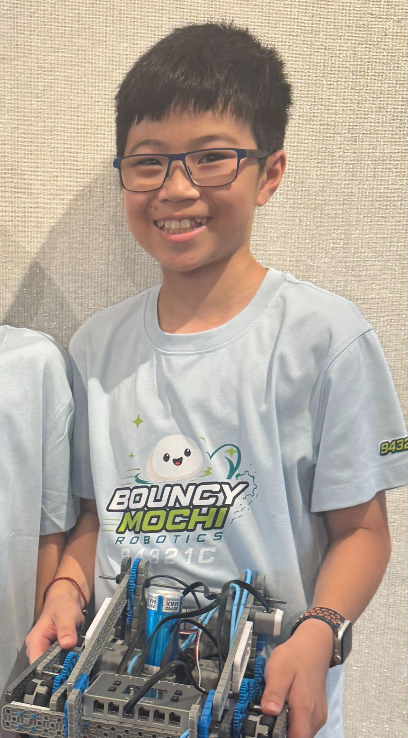
Our Team
Meet the Team
Photo
照片
Leo
Role(s) on the team:
Main Designer, Builder, Driver
Grade · Years in VEX IQ:
7th grade · 3rd year in VEX IQ
Something I like outside robotics:
Ping pong, math, and reading
My goal this season:
Go to Worlds!
Photo
照片
Jasper
Role(s) on the team:
Main Coder, Driver, Engineering Notebook Taker
Grade · Years in VEX IQ:
6th grade · 2nd year in VEX IQ
Something I like outside robotics:
Video games, chess, and crochet
My goal this season:
To get better scores at each competition
Photo
Benjamin
Role(s) on the team:
Second Builder, Driver, Loader
Grade · Years in VEX IQ:
6th grade · 1st year in VEX IQ
Something I like outside robotics:
Basketball and video games
My goal this season:
Get more experience and aim for Regionals and Worlds
Jasper
08/15/2026
2

Slide 11
Our Team
Team Roles
Job | Main | Backup | What this job means
Building | Leo | Benjamin | Builds and fixes the robot, and keeps it strong.
Designing | Leo | Jasper | Plans and sketches ideas, then picks the best design.
Driver 1 | Leo | Jasper | Drives the first part of the match. Knows the whole route.
Driver 2 | Jasper | Benjamin | Drives after the switch. Knows the whole route too.
Coding | Jasper | Leo | Writes and tests the driver and autonomous code.
Loading | Benjamin | Jasper | Communicate with the other team. Loads bean bags one at a time, quickly and by the rules.
Notebook | Jasper | Leo | Writes what we did each session, with date and photos.
Notebook check | Benjamin | Leo | Checks every page has a date, name and page number.
Batteries & parts | Benjamin | Jasper | Charges batteries and packs spare parts and tools.
In a Match
How we share driving and loading in a match？
In every teamwork match, two of us drive and one of us loads. Leo drives first, and Jasper takes over at the driver switch. This season, the loaders swap: Benjamin loads for our alliance partner, and their loader loads for us. So before each match, Benjamin talks with the partner team. He shows their loader how our robot needs the bean bag, and asks how they want theirs loaded. Both drivers practice the whole route, and in practice we rotate jobs so everyone can be a backup.
Why we picked these jobs (what each person is good at or wants to learn).
Leo has the most VEX IQ experience (3rd year), so he leads designing and building, and he drives. He likes math, which helps with gear ratios and measuring. Jasper is our main coder and also keeps our notebook. He likes chess, and thinking a few steps ahead helps with coding and strategy. Benjamin is in his first year and wants more experience, so he is our second builder, loader and driver. He learns building from Leo, so he can be the backup builder.
Jasper
8/20/2026
3

Slide 12
Our Team
Team Agreement
1
No blaming! 🙅
If something breaks, we fix it together. Nobody says “it’s your fault.”
2
Be a hype teammate 📣
We say “nice try!” and “we got this!” even after a bad match.
3
Clean up our mess 🧹
Parts go back in the right bin. No pins on the floor (ouch!).
4
Every idea gets a turn 💡
We listen first, then talk. Even weird ideas get tested, because they might work!
5
Stay bouncy like a mochi 🍡
We never give up, we have fun, and we win or lose as a team.
Signed By
Name / Date
Name / Date
Name / Date
Jasper
8/20/2026
4

Slide 13
Our Team
Season Goals
Starting Point
Where we start: our best Skills score is 90 points (Auton 0 + Driver 90), from our competition on 9/12/2026.
Goal | How we will measure it | By when | Done?
Score in Autonomous Skills | Auton score above 40 | 10/25/2026
Reach top 40% in Elementary Skills | Skills total of about 150+ | 10/25/2026
Make it to Regional Championship |  | 1/31/2027
Make it to World Championship |  | 3/1/2027
Learning Goals
Leo: I want to learn how to design a mechanism that can score on Level 4, and plan it with sketches before I build it.
Jasper: I want to learn how to write an autonomous program that uses sensors, so we can finally score points in Autonomous Skills.
Benjamin: I want to learn how to build a whole subsystem by myself, and drive our Skills route smoothly.
Jasper
09/13/2026
5

Slide 14
Understanding the Game

Slide 15
Game Analysis
2026–2027 VEX IQ Level Up Game Analysis
The Game
In Level Up, robots score bean bags on a pyramid goal or on the L4 goal. A bean bag is about 3" x 4". It is easy to pick up, but it has to be placed very precisely. The pyramid has three levels. Each bean bag of the right color (or yellow) is worth 3 points on Level 1, 6 points on Level 2, and 12 points on Level 3. Only yellow bean bags can score on the L4 goal, for 16 points each.
Our Target
For our first competition (9/12/2026), we aimed for Level 3. Our robot could score on Level 3, but it was not reliable enough to reach Level 4 every time.
Field Challenges for Our Robot
What we measured | Size | What it means to our robot?
Level 3 of the pyramid | 8" tall | Our robot has to lift the bean bag high enough to place it on top.
Space under the barriers | under 6.25" | Our robot must be shorter than 6.25" when folded to drive under the barriers.
Ramp up to the pyramid | 0.75" high | We could not just center the wheels the normal way. We placed them so the robot climbs the ramp without getting stuck.
Load zone → scoring zone | about 66" | Every trip is a long drive, so driving speed really matters.
Loading for Each Other
This season, our robot starts on the opposite side from our loading zone, so the two alliance teams load for each other instead of for their own robot. That makes good communication really important. Before every match we agree with our partner on when to load, how to place the bean bag, and what to avoid.
Jasper
8/30/2026
7

Slide 16
Game Analysis
Game Rules in Our Own Words
1
Robot size limits (at the start and during the match)
At the start, our robot has to fit in an 11" x 20" x 15" box. After the match starts, it can grow as TALL as we want, but it can only get up to 24" long and never wider than 11". (SG1–SG3)
2
Match length and switching drivers
A teamwork match is 60 seconds, and 2 robots work together as an alliance. Our 2 drivers must switch the controller when the timer shows between 0:35 and 0:25. Nobody can drive for more than 35 seconds. (GG11)
3
Loading zone rules
You load for the other team‼ Load ONE bean bag at a time, only when the load zone is empty. Red bags go in the red zone, blue in the blue. The bag must sit flat on the floor, all the way inside. Once you let go, no touching it again! (SG7)
4
How many bean bags the robot may control at once
Only ONE! Our robot can’t hold or push (plow) two bean bags at the same time. Bumping one for a second is OK, but pushing it more than about one tile counts as plowing. (SG6)
5
What happens if a bean bag leaves the field
It’s gone for good. It doesn’t come back, and the loader can’t put it back in. A bean bag that ends up stuck inside the pyramid also counts as out of the field. (SG4)
6
Skills Challenge rules (Autonomous and Driver)
Skills = 1 minute, just our robot. Driving Skills: we drive. Autonomous Skills: the robot runs our code, and we start it with a button on the brain or a sensor (no controller!). We get 3 tries of each. Our score = best auton + best driver. (RSC6, T15, T17)
Questions
Rules we were not sure about.
If a bean bag touches the L3 shelf on top, but is also sitting on a bean bag that is on L2, how many points is it?
What we found out: It counts only for the HIGHER level, so it scores 12 points on L3, not 6. (It still has to be our color or yellow, and not touching a robot.)
Where we checked: Game Manual rule <SC4> and Figure SC4-1, which shows this exact case.
Jasper
8/30/2026
8

Slide 17
Game Analysis
Scoring Rules
Goal | Points per bean bag | Which bean bags count | Notes
Floor Goal | 1 | Our color or yellow | The whole bag is inside the goal, and not touching a robot.
Level 1 | 3 | Our color or yellow | Touching the L1 shelf, or sitting on a stack of bags that is.
Level 2 | 6 | Our color or yellow | Same as L1, but on the L2 shelf.
Level 3 | 12 | Our color or yellow | If a bag touches 2 levels, it only counts for the higher one.
Level 4 | 16 | YELLOW only! | Only 6 yellow bags in the game. Each robot starts with 1 as a preload.
Our Math
One trip (pick up → score → back) takes about 10 seconds.
In 60 seconds we can make about 6 trips.
6 trips × 12 points = 72 points on Level 3.
0 trips × 16 points = 0 points on Level 4.
(as of 8/30/2026)
What We Learned
Level 3 is our best goal right now. It gives us 72 points in 60 seconds, and we can’t score on Level 4 yet. Every second we save on a trip helps: if one trip took 8 seconds instead of 10, we could make about 7 trips = 84 points! Level 4 gives 4 more points per bag, but only yellow bags count and there are only 6 in the whole game. So Level 4 can add a few bonus points, but most of our points will come from fast Level 3 trips.
Jasper
9/2/2026
9

Slide 18
Game Analysis
Our Strategy
Goal #1
Score on Level 3 fast and every time. Right now one trip takes about 10 seconds (6 trips = 72 points). We want to make our trips faster, so we can do 7 or more trips in a match.
Goal #2
When Level 3 is reliable, we add Level 4 with yellow bean bags (16 points each!), starting with our yellow preload.
Skip
What we will NOT spend time on, and why.
Floor Goal (1 point) and Level 1 (3 points). One trip takes the same time but gives way fewer points. We only use them if there isn’t enough time left for one more Level 3.
Teamwork Plan
Before every match, we meet our partner team. We decide who scores where, so our robots don’t crash into each other. Benjamin loads for them, and their loader loads for us, so we show them our “How to Load” page. Our drivers practice a fast controller switch between 0:35 and 0:25.
Skills Plan
Autonomous route and Driver route.
Driving Skills: do our fast Level 3 trips with a smooth loading rhythm. Autonomous Skills: our auton score is 0 right now, so first we will code a simple routine that scores our preload, then add more trips. Every auton point adds to our total, and auton score is also the first tiebreaker.
Jasper
9/2/2026
10

Slide 19
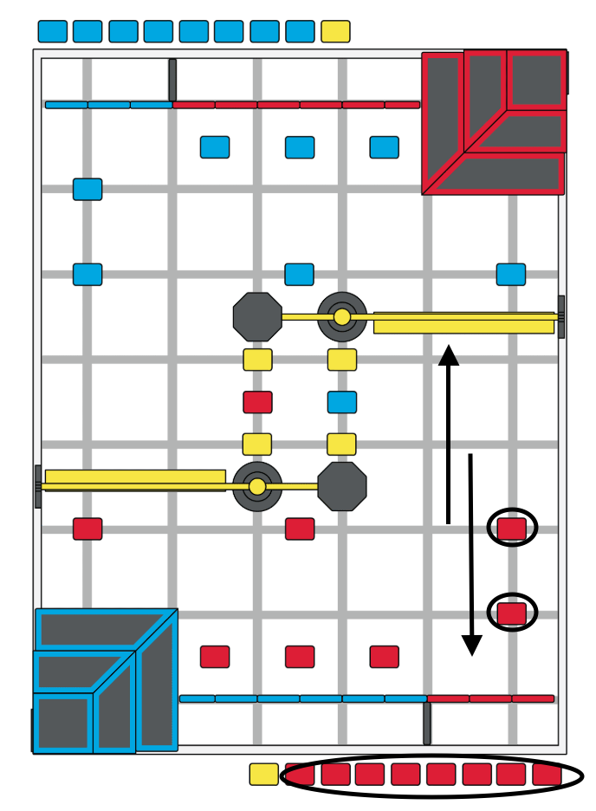
Our Route
Jasper
9/2/2026
11

Slide 20
Robot 1: FLOP
(Modified Hero Bot)

Slide 21
Robot 1 – Design
Identify the Problem
STEP 1
Must Do
What must our robot be able to do? (list the must-haves)
机器人必须做到哪些事？（列出必须项）
Constraints
Limits we must design within: size, number of motors, parts we have, rules.
设计限制：尺寸、电机数量、现有零件、规则。
Success Looks Like
How will we know it works? Write a number. (e.g. scores Level 3 in 9 of 10 tries, one trip under 6 seconds)
怎么判断成功？写一个数字。（例如：10 次里 9 次能投进 L3、一趟少于 6 秒）

Slide 22
Robot 1 – Design
Brainstorm Ideas
STEP 2
头脑风暴 · 至少想 3 个方案
Sketch or photo of Idea A
方案 A 的草图或照片
Idea A: ____________
How it works:
原理：
Good:
优点：
Not so good:
缺点：
Sketch or photo of Idea B
方案 B 的草图或照片
Idea B: ____________
How it works:
原理：
Good:
优点：
Not so good:
缺点：
Sketch or photo of Idea C
方案 C 的草图或照片
Idea C: ____________
How it works:
原理：
Good:
优点：
Not so good:
缺点：

Slide 23
Robot 1 – Design
Choose the Best Idea
STEP 3
比较方案，选出最好的
Score each idea 1–5 for each reason. Multiply by the weight (1–3). Add them up.
每项给每个方案打 1–5 分，乘以权重（1–3），最后加总。
What matters 比较项 | Weight 权重 | Idea A 方案 A | Idea B 方案 B | Idea C 方案 C
Points it can score
Speed (trip time)
Reliability
Easy to drive
Easy to build & fix
Motors / parts needed
TOTAL
Our Choice
We chose Idea ___ because…
我们选了方案 ___，因为……
Risks
What we are worried about with this idea, and how we will test it.
这个方案我们担心什么，打算怎么测试。

Slide 24
Robot 1 – Build
Subsystem: Drivebase
STEP 4
子系统：底盘 · 照片上标数字，下面逐条解释
Photo of the subsystem — add number labels 1, 2, 3, 4
子系统照片 —— 在照片上标出数字 1、2、3、4
# | Part 零件 | What it does / why we built it this way 作用 / 为什么这样设计
1
2
3
4
Specs
Key numbers: gear ratio, motors used, sensors, rubber bands…
关键数据：齿轮比、用了几个电机、传感器、橡皮筋数量……

Slide 25
Robot 1 – Build
Subsystem: Intake / Claw
STEP 4
子系统：取物机构 / 爪子 · 照片上标数字，下面逐条解释
Photo of the subsystem — add number labels 1, 2, 3, 4
子系统照片 —— 在照片上标出数字 1、2、3、4
# | Part 零件 | What it does / why we built it this way 作用 / 为什么这样设计
1
2
3
4
Specs
Key numbers: gear ratio, motors used, sensors, rubber bands…
关键数据：齿轮比、用了几个电机、传感器、橡皮筋数量……

Slide 26
Robot 1 – Build
Subsystem: Scoring Mechanism
STEP 4
子系统：得分机构 · 照片上标数字，下面逐条解释
Photo of the subsystem — add number labels 1, 2, 3, 4
子系统照片 —— 在照片上标出数字 1、2、3、4
# | Part 零件 | What it does / why we built it this way 作用 / 为什么这样设计
1
2
3
4
Specs
Key numbers: gear ratio, motors used, sensors, rubber bands…
关键数据：齿轮比、用了几个电机、传感器、橡皮筋数量……

Slide 27
Robot 1 – Build
Build Log
STEP 4
搭建记录 · 每次上课都记一行
Date 日期 | What we built or changed 搭了 / 改了什么 | Who 谁 | Problem we found 发现的问题 | Next step 下一步

Slide 28
Port
Port
Port
Port
Port
Port
Port
Port
Port
Port
Port
Port

Slide 29
Bumper
Bumper
Bumper
Bumper
Stick
Stick
Stick
Stick
Stick
Stick
Button
Button
Button
Button

Slide 30
Robot 1 – Code
Code: Driver Control
STEP 5
程序：手动控制程序 · 截图 + 用自己的话解释
Screenshot of the code — add number labels next to the important blocks
程序截图 —— 在重要的积木旁边标数字
What It Does
What this code does, in one or two sentences.
这段程序做什么（一两句话）。
How It Works
How it works, step by step (match the numbers on the screenshot).
一步步讲原理（对应截图上的数字）。
Bugs & Fixes
A bug we found and how we fixed it.
遇到的 bug 和修复方法。

Slide 31
Robot 1 – Code
Code: Autonomous
STEP 5
程序：自动程序 · 截图 + 用自己的话解释
Screenshot of the code — add number labels next to the important blocks
程序截图 —— 在重要的积木旁边标数字
What It Does
What this code does, in one or two sentences.
这段程序做什么（一两句话）。
How It Works
How it works, step by step (match the numbers on the screenshot).
一步步讲原理（对应截图上的数字）。
Bugs & Fixes
A bug we found and how we fixed it.
遇到的 bug 和修复方法。

Slide 32
Robot 1 – Code
Autonomous Plan
STEP 5
自动程序规划 · 先在场地图上画路线
Draw the route here, or copy the Field Map page and draw on it
在这里画路线，或复制场地图页面在上面画
Step 步骤 | What the robot does 机器人做什么 | How it knows to stop (sensor / distance / time) 怎么知道该停（传感器 / 距离 / 时间） | Points 得分
1
2
3
4
5
6
7
8
Target score for this routine: ____ Best so far: ____
这段自动程序的目标分：____ 目前最好：____

Slide 33
Robot 1 – Test
Test Plan & Results
STEP 6
测试：一次只改一处，测 10 遍
The problem, in one sentence:
问题是什么（一句话）：
The ONE change we made:
我们只改了这一处：
How we test it (same spot, same setup, same driver):
怎么测（同一个位置、同样的设置、同一个车手）：
Trial 次数 | 1 | 2 | 3 | 4 | 5 | 6 | 7 | 8 | 9 | 10
Before
After
Mark ✓ or ✗, or write the score. Success rate before: ___/10 after: ___/10
每次打 ✓ 或 ✗，或写分数。改之前成功率 ___/10，改之后 ___/10
☐ Keep the change ☐ Put the old part back
☐ 保留这个改动 ☐ 换回原来的
Decision
Why? What did the numbers show? What will we test next?
为什么？数据说明了什么？下一步测什么？

Slide 34
Robot 1 – Test
Practice Score Log
STEP 6
练习得分记录 · 每一轮都记
Date 日期 | Run 第几轮 | Type 自动/手动/团队 | Driver 车手 | Score 分数 | What went wrong / what went well 问题 / 亮点
Best score: ____ Average of last 10: ____
最高分：____ 最近 10 次平均：____

Slide 35
Robot 1 – Test
Problems & Solutions
STEP 6
问题和解决方法
Problem 1 问题 1
What happened:
发生了什么：
Why it happened (root cause):
根本原因：
What we changed:
我们改了什么：
Did it work? How do we know (numbers)?
有效吗？用数字说明：
Problem 2 问题 2
What happened:
发生了什么：
Why it happened (root cause):
根本原因：
What we changed:
我们改了什么：
Did it work? How do we know (numbers)?
有效吗？用数字说明：
Problem 3 问题 3
What happened:
发生了什么：
Why it happened (root cause):
根本原因：
What we changed:
我们改了什么：
Did it work? How do we know (numbers)?
有效吗？用数字说明：

Slide 36
Robot 1 – Evaluate
Robot Evaluation
STEP 7
评估这台机器人
Pros 优点
What works well, and why it matters for scoring.
做得好的地方，以及对得分的帮助。
Cons 缺点
What does not work well, and how many points it costs us.
做得不好的地方，以及让我们少得多少分。
Did We Meet Our Goals? 达到目标了吗？
Goal (from Step 1) 目标（第 1 步定的） | Target 目标值 | What we got 实际结果
Decision
☐ Keep improving this robot ☐ Build a new robot. Why?
☐ 继续改进这台 ☐ 做一台新的。原因是？

Slide 37
Robot 1 – Evaluate
What We Learned
STEP 7
学到了什么、下一步
1
Lesson: (e.g. 'Sensors beat timers: our auton works on low battery now')
经验：（例如：用传感器代替定时，电量低时自动程序也能跑准）
2
Lesson:
经验：
3
Lesson:
经验：
4
Lesson:
经验：
Next Steps
Next steps: what we will try next and why.
下一步：接下来要尝试什么，为什么。

Slide 38
Competitions
比赛记录
Use one Competition Review and one Personal Reflection per member for every event.
每场比赛写一份比赛复盘，每个队员写一份个人反思。

Slide 39
Competitions
Packing List & Match Checklist
出发清单和赛前检查 · 出过的问题都加进来
Packing List 出发前带齐
Before Every Match 每场比赛前检查
☐ Robot + controller
☐ Batteries (charged) + spares
☐ Battery charger
☐ Tools & spare parts
☐ Rubber bands
☐ Laptop + cable
☐ Notebook & summary pages
☐ ______________
☐ ______________
☐ ______________
☐ Battery charged
☐ Correct program loaded
☐ All wires plugged in & clipped
☐ Air tank filled, no leaks
☐ Rubber bands OK
☐ Shake test: nothing loose
☐ Starting position lined up
☐ ______________
☐ ______________
☐ ______________
Lessons From Past Events
Things that went wrong at an event that this checklist would have caught. Add them to the lists above.
比赛中出过的问题，如果有检查清单就能避免的，写在这里，并加到上面的清单里。

Slide 40
Competitions
Competition Review
比赛复盘
Event: ______________________ Date: ________ Location: ______________
比赛名称 / 日期 / 地点
Qual. rank 资格赛排名 | Auton 自动 | Driver 手动 | Skills total Skills 总分 | Finals 决赛 | Awards 奖项
Match by Match 逐场记录
Match 场次 | Partner 队友 | Score 分数 | What went well 做得好的 | ONE thing to fix 只写一条要改的
Biggest Lesson
The biggest lesson from this event, and what we will change before the next one.
这场比赛最大的收获，以及下一场之前要改什么。

Slide 41
Competitions
Personal Reflection
个人反思 · 每个队员一页（复制本页）
Name: ______________ Event: ______________________
What I Did Well
What I did well at this event.
这场比赛我做得好的地方。
What I Can Improve
What I can improve. Be specific.
我可以改进的地方，写具体。
Next Time I Will…
One thing I will do differently at the next event.
下一场比赛我要做的一个改变。

Slide 42
Appendix
附录 · 计划、场地图、参考资料

Slide 43
Week of: MM/DD/YYYY

Slide 44
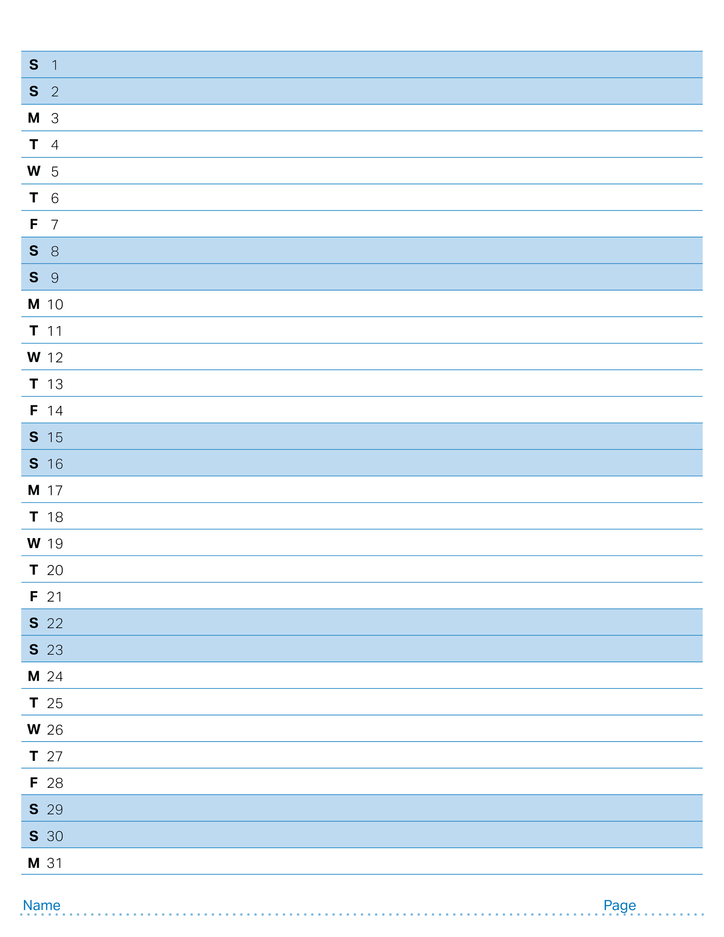
August 2026

Slide 45
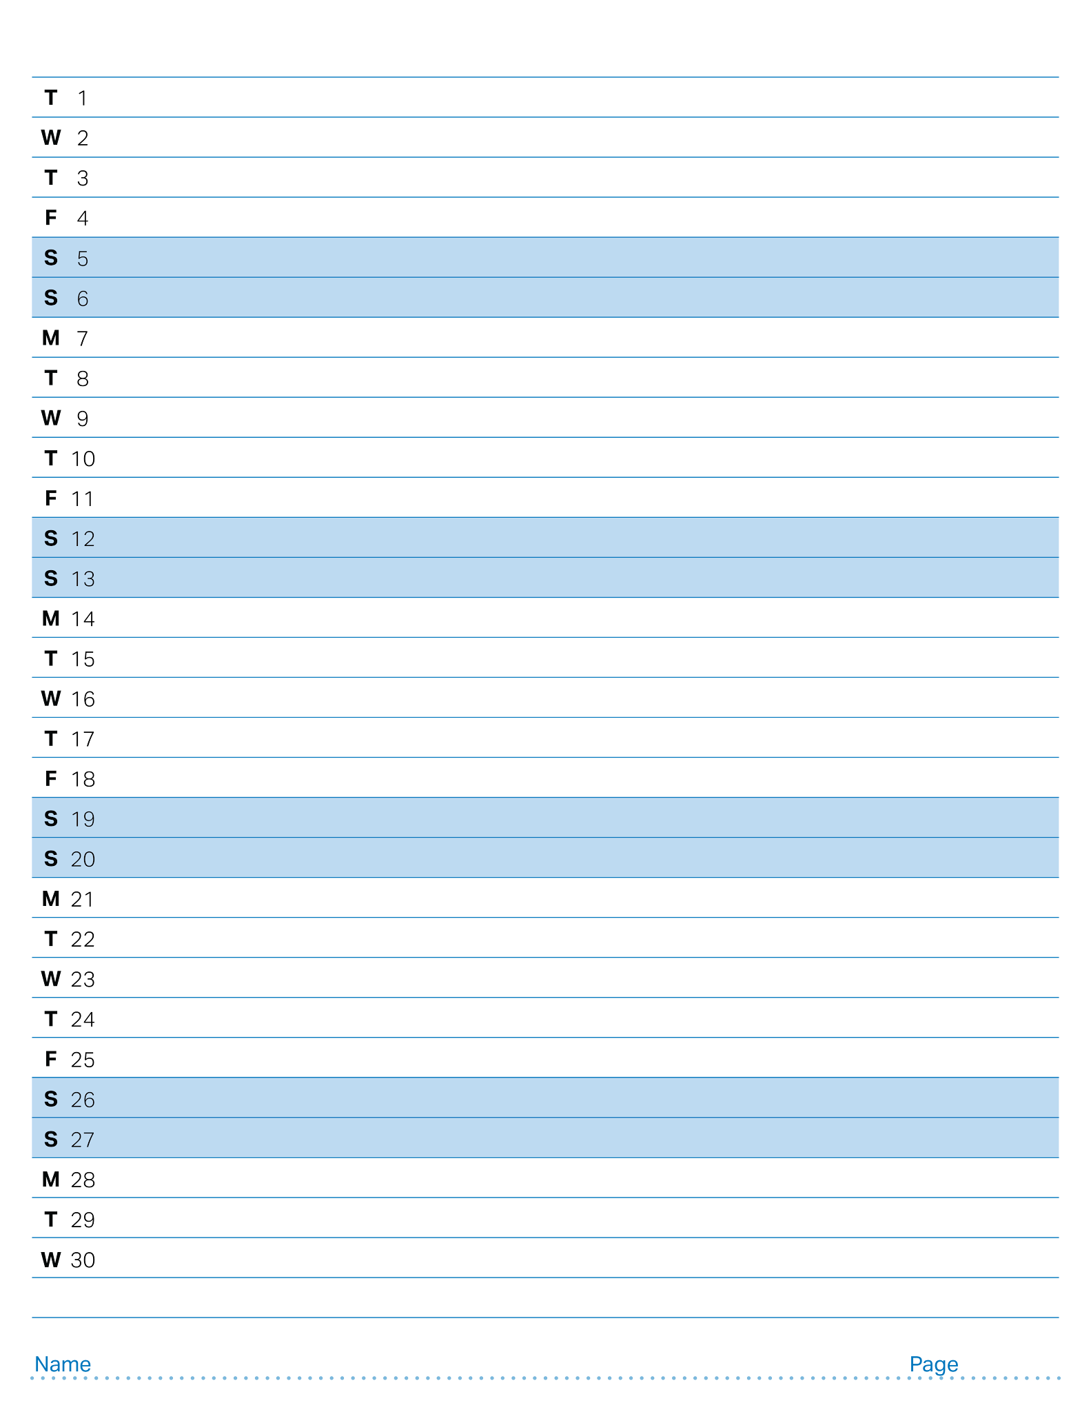
September 2026

Slide 46
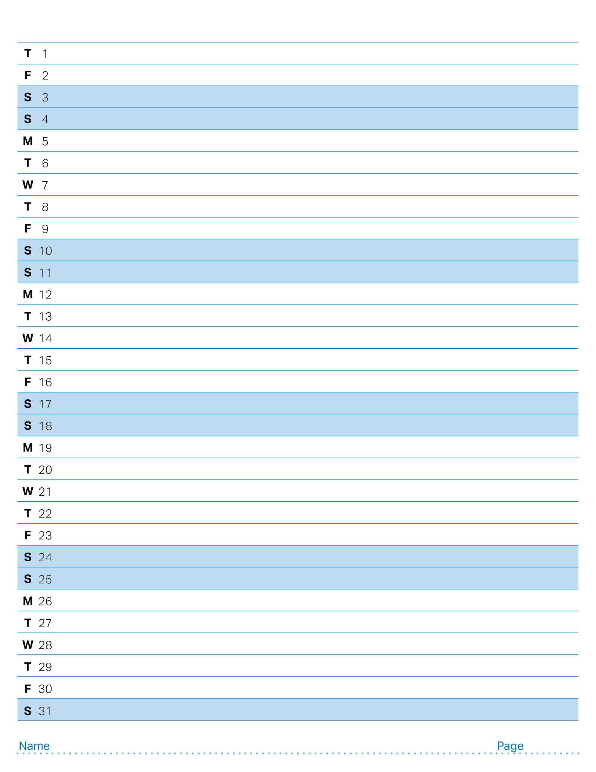
October 2026

Slide 47
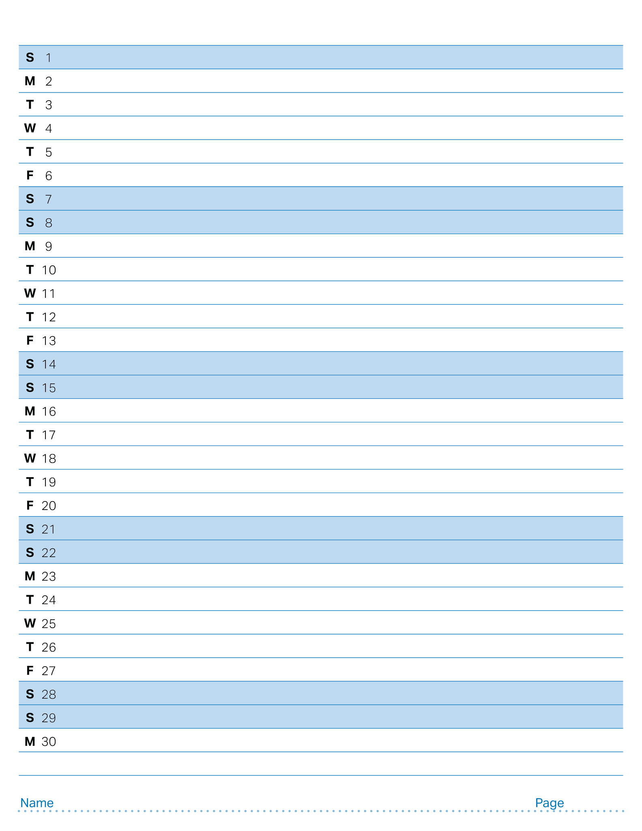
November 2026

Slide 48
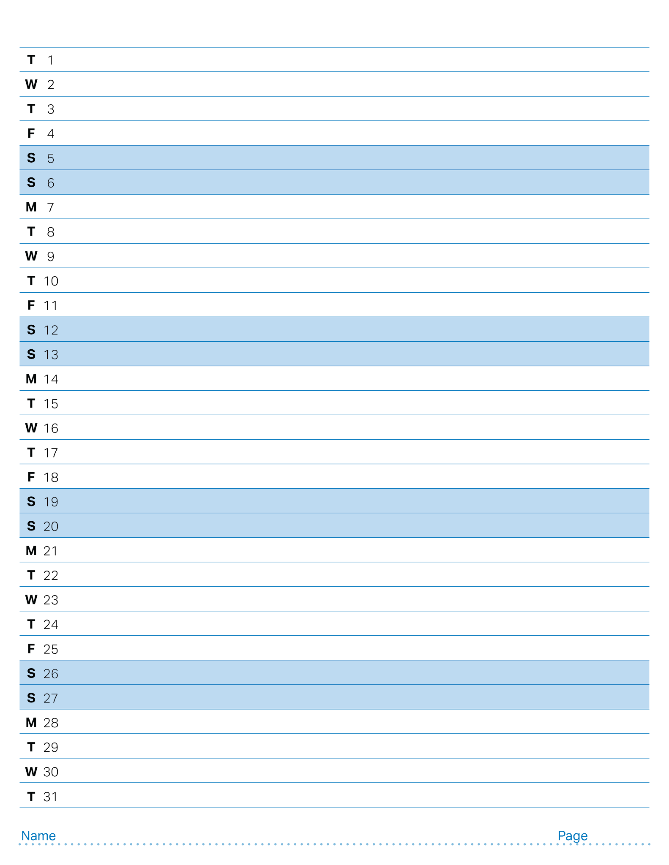
December 2026

Slide 49
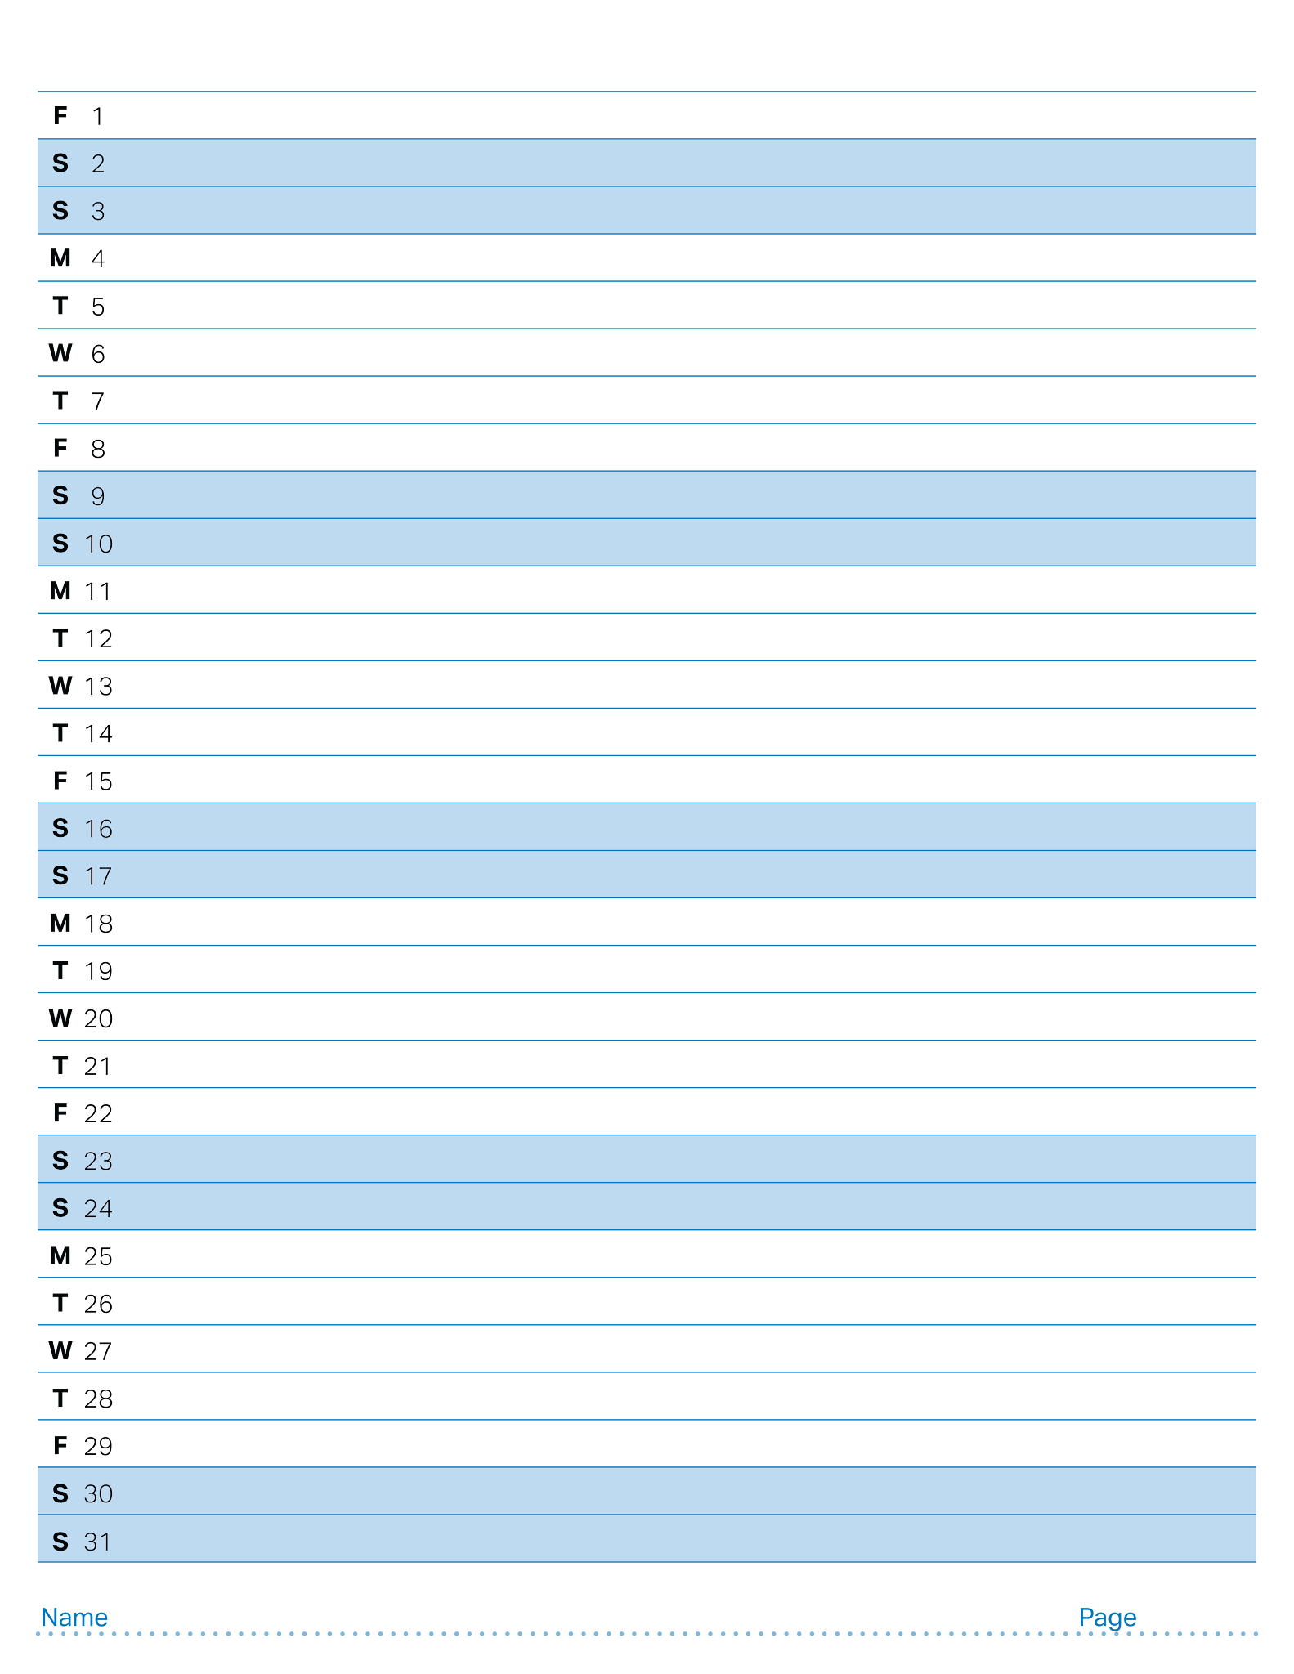
January 2027

Slide 50
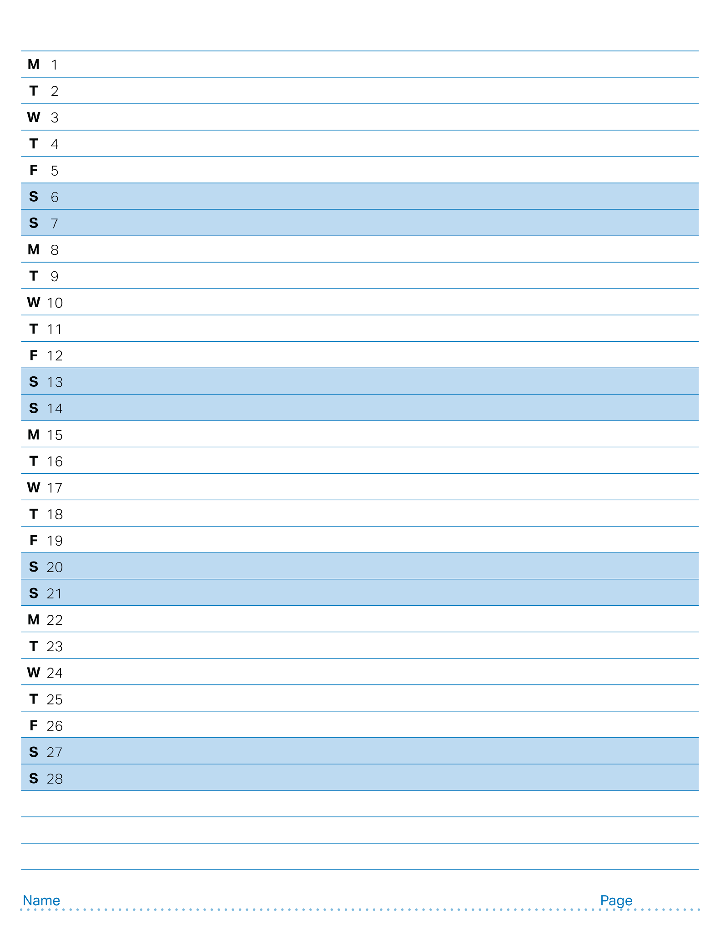
February 2027

Slide 51
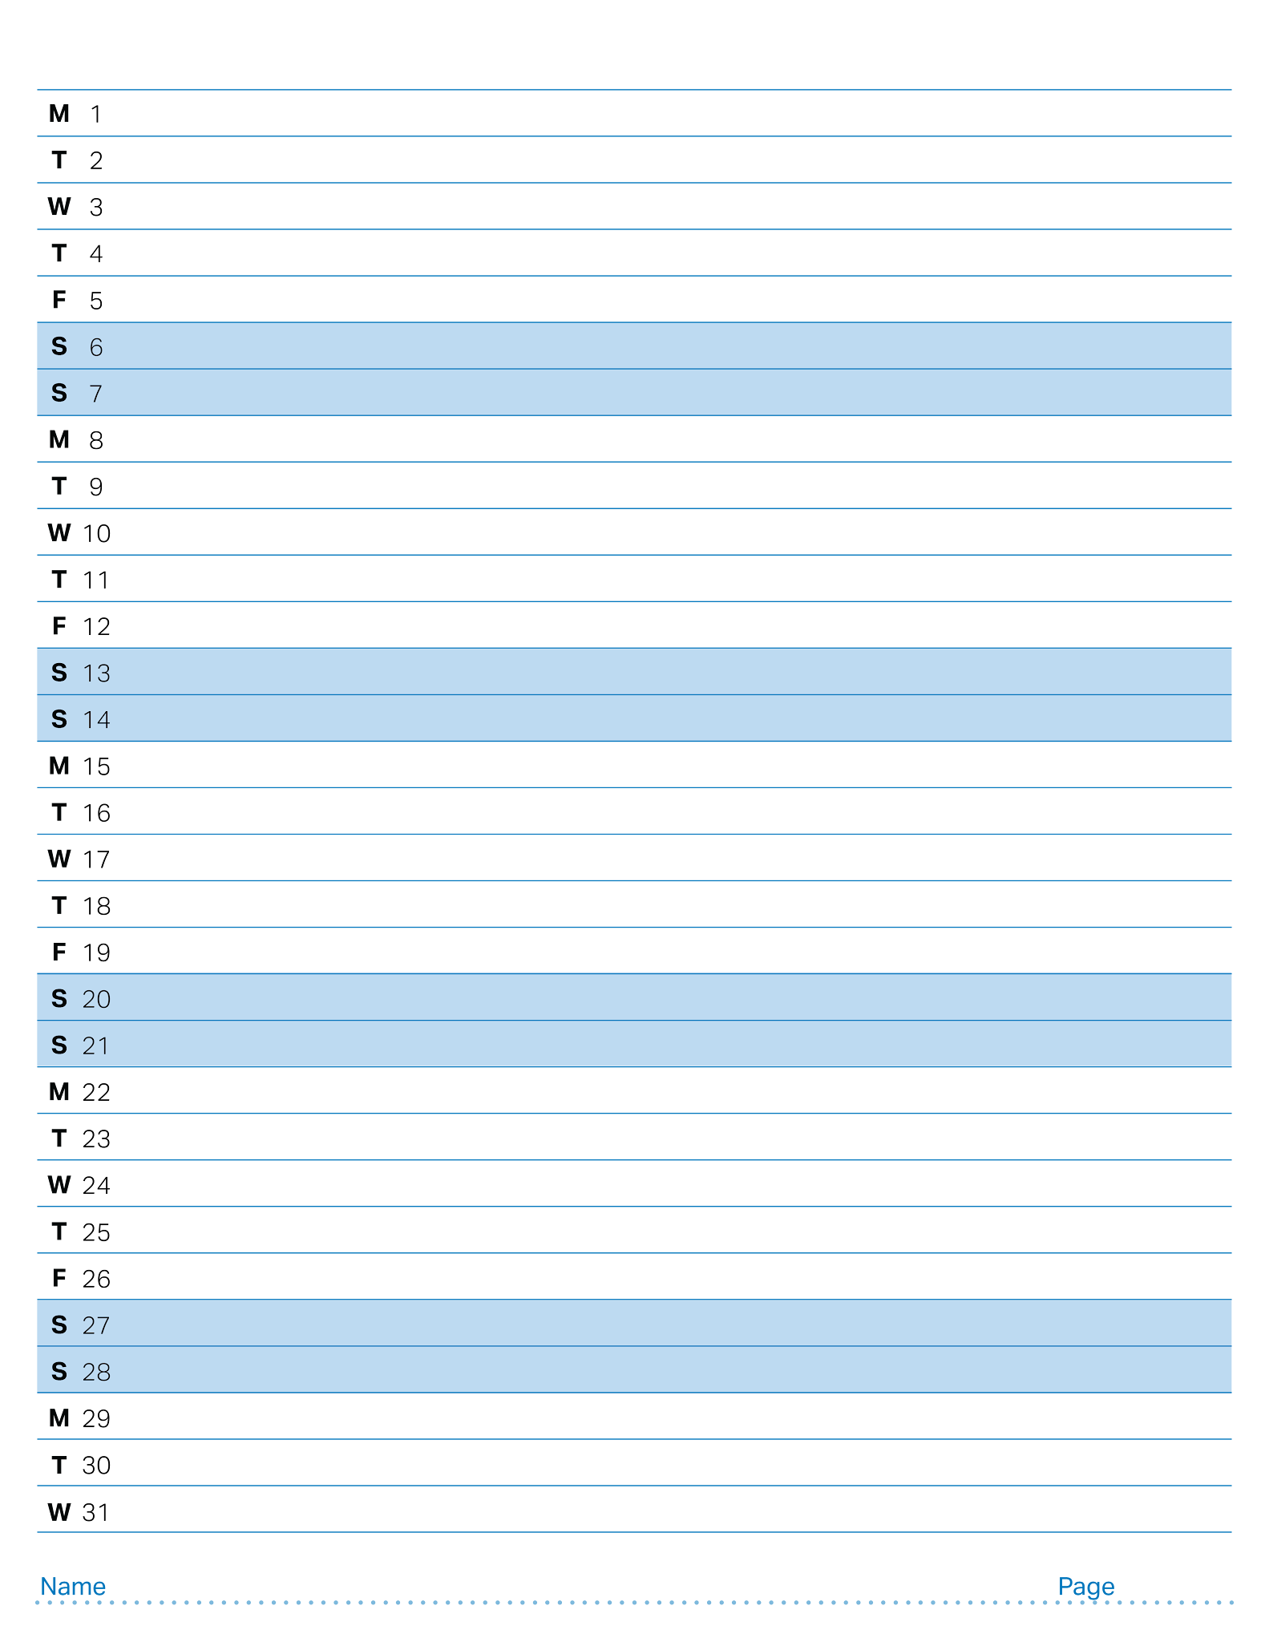
March 2027

Slide 52
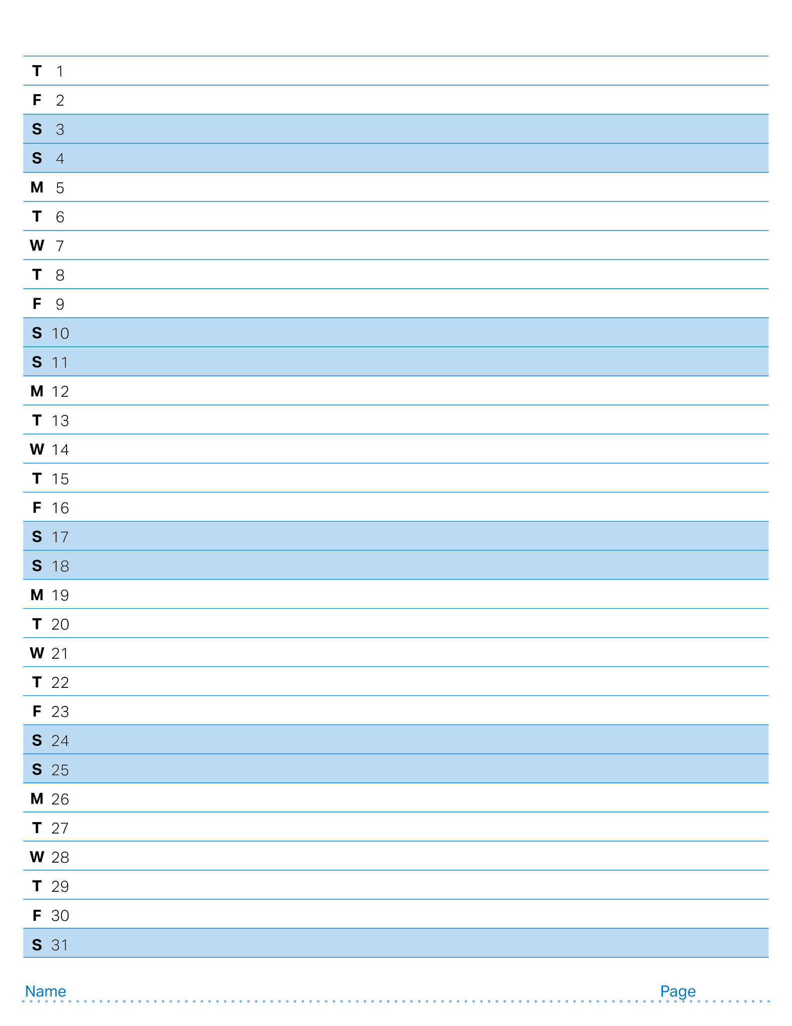
April 2027

Slide 53
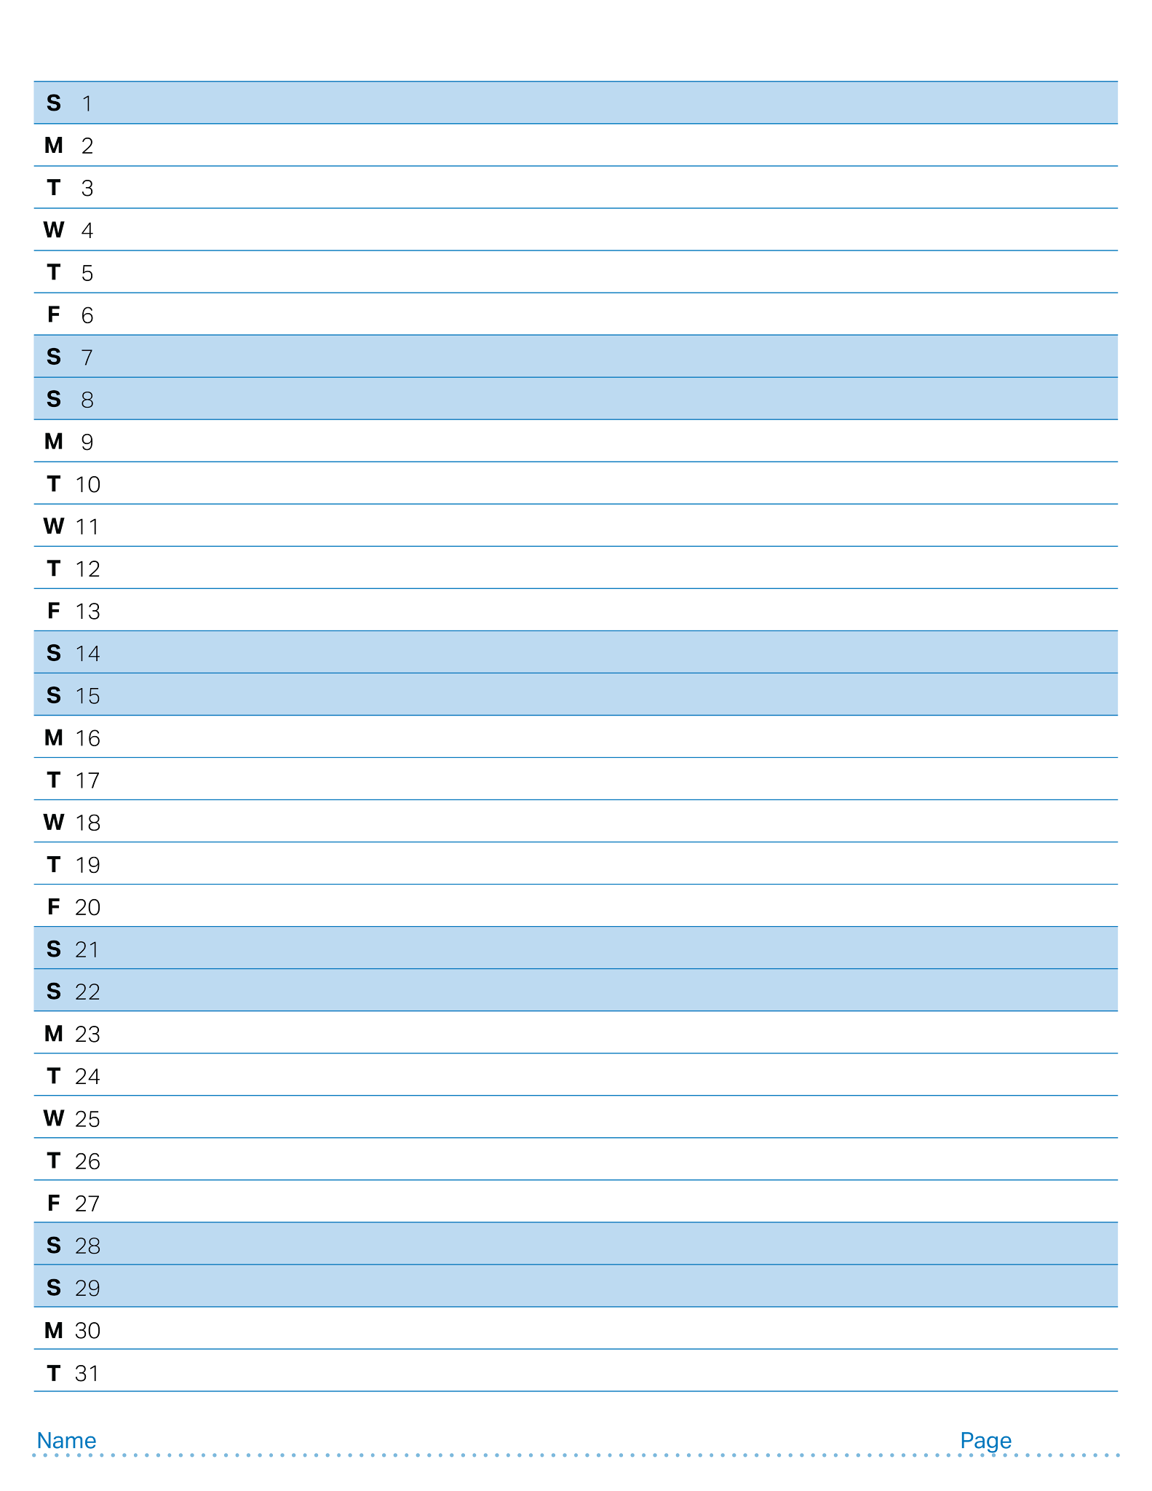
May 2027

Slide 54
“Level Up” Blank Field

Slide 55



“Level Up” Starting Field with Moveable Game Objects

Slide 56
“Level Up” Starting Field with Static Game Objects

Slide 57
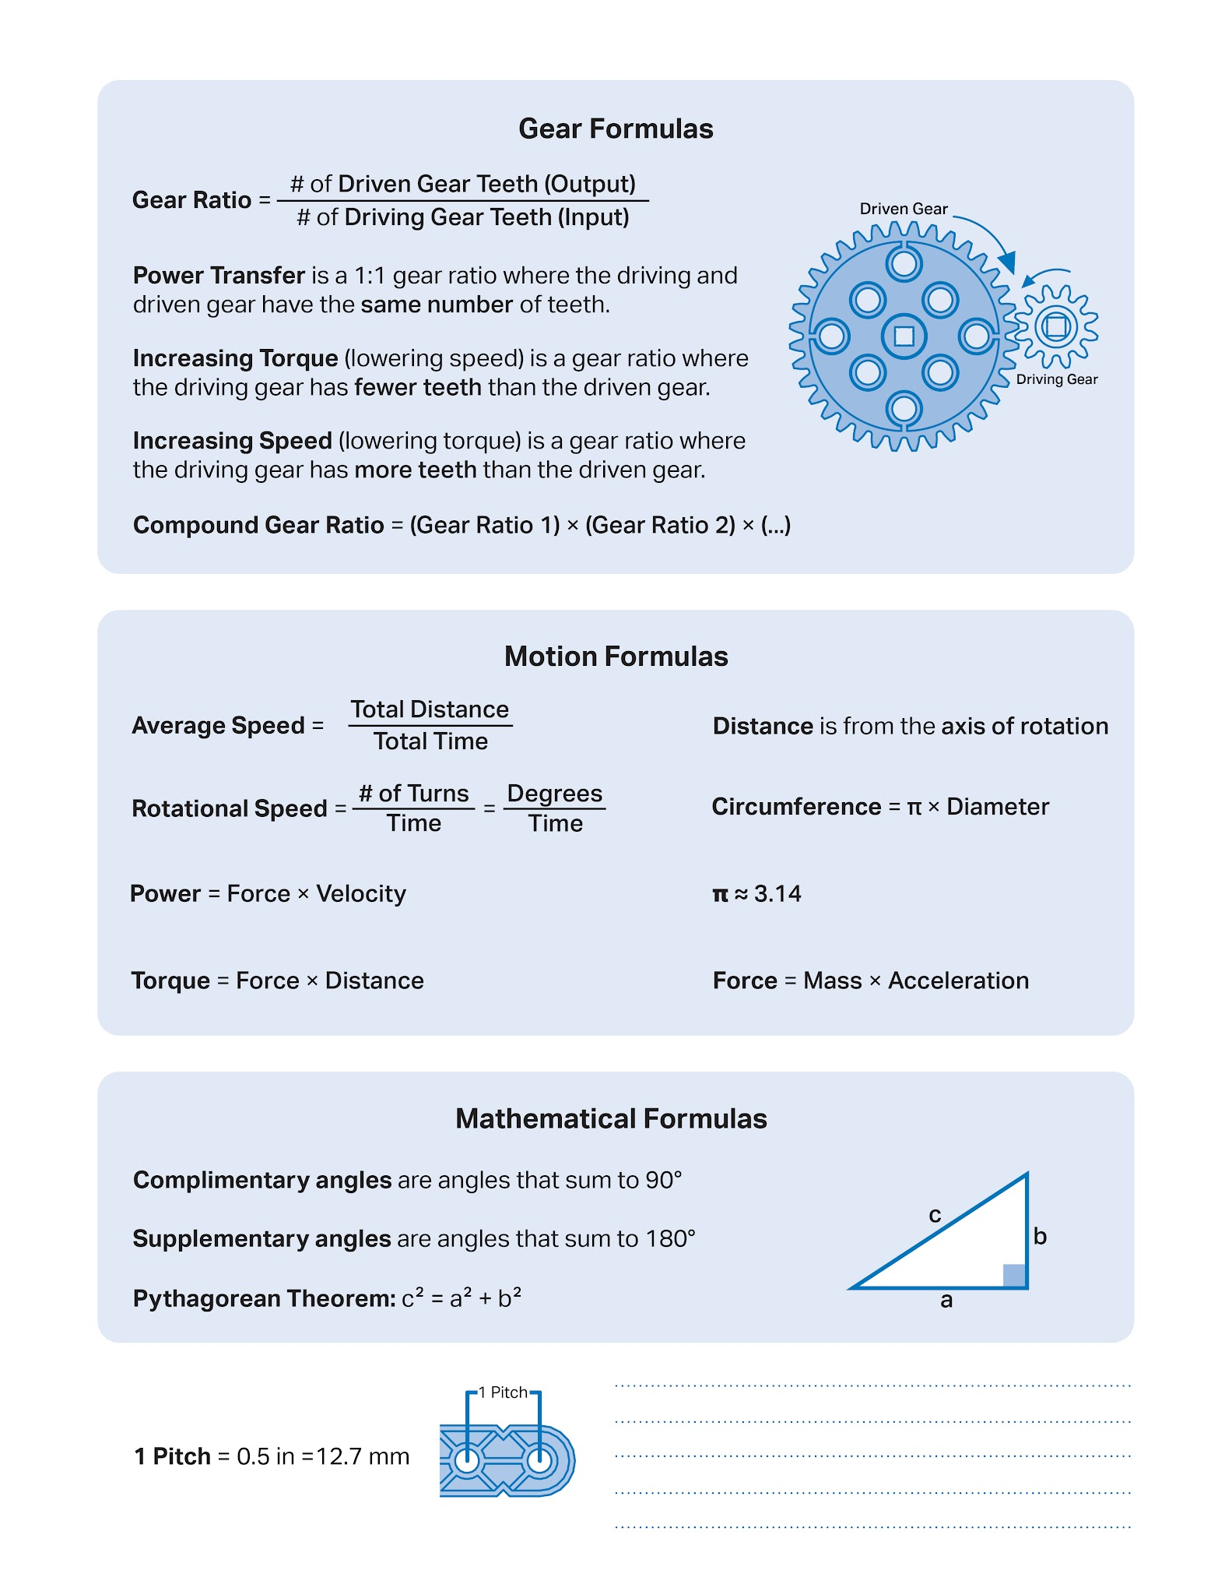

Slide 58


